Slide 1
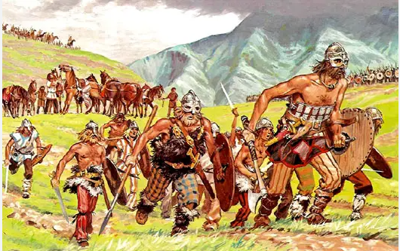
English
Text: How to train your dragon
Really Remarkable Reptiles
Fiction: We will continue to explore sentence and paragraph construction with varied word classes (adjectives, adverbs, conjunctions and prepositions) and sentence openers to interest our readers. We will write a range of text types including descriptive and comparative paragraphs, which will lead us into writing a story.
Non-fiction: We will consider features of non-fiction text types including discussion texts. Our final copies will then need to use all key features.
History
Enquiry Question:
Dickens class will look at out timeline and place the Anglo- saxon and Viking periods against each other and against topics we have already covered in history. We will compare the reasons for the vikings invasion in Britain, including the effect this has on Anglo-Saxon life. We will look at the kings of the Anglo-Saxon period and suggest ways in which they helped to change Britain and how we see this today. We will look at the evidence for and against the Vikings being ‘vicious’ and use secondary sources to decide this.
Maths
Year 4
Recognise place value of 4 digit number and represent and compare these numbers.
Rounding to the nearest 10,100 and 100
Select appropriate strategies to add and subtract
Year 5
Read, write, order and compare numbers up to one million and round to the nearest multiples of ten
Roman numerals upto M
Use a range of mental calculation strategies to add and subtract integers
•Illustrate and explain the written method of column addition and subtraction
Dickens Class
Year 4 & 5 Curriculum Map
Term 1
Is everything connected?
Science
Topic:
During this scientific topic, we will explore how we know the Earth is round and how the solar system was formed. We will explore the phases of the moon and even conduct our own scientific experiments
French
We will recap the days of the week and months of the year. We will be learning more phonetic sounds that we see within french writing and learn new vocabulary for the home we live in.
RE
Enquiry Question: Why do people believe in God?
We will be looking at why Christians believe in God and who does not believe in God. We will be investigating this by looking at both sides of the discussion.
PE
This term in PE we will be focusing on our skills with a football, including showing great sportsmanship. We aim to increase our accuracy in passing.
Art / DT
Artist:Friedensreich Hundertwasser
We will be looking at formal elements of art and drawing and using these to imitate the work of Friedensreich Hundertwasser. We will be looking at what influenced Friedensreich Hundertwasser and how this developed through his art.
Music
Melody and Harmony in Music
We will be recognising melody using instruments and singing.
PSHE / Jigsaw
Topic: Being Me In My World
We will address being part of a team and knowing how we belong.
Computing
Sharing information- Know how devices and systems work and are protected. Use search engines safely.

